Slide 1

Resume Screening/Parsing
By Sana Jalgaonkar
25/06/2022

Slide 2

Agenda
Introduction & Aim
Business Problem
Dataset
Process Followed
Conclusion
Summary
What’s Next?
Thank you.

Slide 3


Introduction and Aim
Companies often receive thousands of resumes for each job posting and employ dedicated screening officers to screen qualified candidates.
Hiring the right talent is a challenge for all businesses. This challenge is magnified by the high volume of applicants if the business is labour-intensive, growing, and facing high attrition rates.
In a typical service organization, professionals with a variety of technical skills and business domain expertise are hired and assigned to projects to resolve customer issues. This task of selecting the best talent among many others is known as Resume Screening.
In this article, I will introduce you to a machine learning project on Resume Screening with Python programming language.
Aim - Understanding the implementation of machine learning algorithm and NLP (Natural Processing Language) using python

Slide 4
Business Problem
It becomes very difficult for the hiring teams to read the resume and select the resume according to the requirement, there is no problem if there are one or two resumes but it is very difficult to go through 1000’s resumes and select the best one.
To solve this problem, this project solution can read and screen the resume using machine learning with Python so that we can complete days of work in few minutes.
We know that the IT department falls short of growing markets. Due to many big projects with big companies, their team does not have time to read resumes and choose the best resume according to their requirements.
To solve this type of problem, the company always chooses a third party whose job is to make the resume as per the requirement. These companies are known by the name of Hiring Service Organization. It’s all about the information resume screen.
The work of selecting the best talent, assignments, online coding contests among many others is also known as resume screen.
Due to lack of time, big companies do not have enough time to open resumes, due to which they have to take the help of any other company. For which they have to pay money. Which is a very serious problem.
To solve this problem, the company wants to start the work of the resume screen itself by using a machine learning algorithm.

Slide 5

DATASET
We have publicly available data from Kaggle. You can download the data using the below link.
https://www.kaggle.com/gauravduttakiit/resume-dataset

Slide 6

Breakout questions
No.
1
How do you define communication?
No.
2
Do you think technology has helped or hindered our ability to communicate with each other?
No.
3
Share your answers with each other.

Slide 7

Process Followed
Imported the Libraries
Importing Data from file to data-frame
Exploratory Data Analysis
Data Processing
Building WordCloud
Model building
Viewing results.

Slide 8
Importing the libraries
NumPy
Pandas
Matplotlib
Seaborn
NLTK
WordCloud
Sklearn

Slide 9
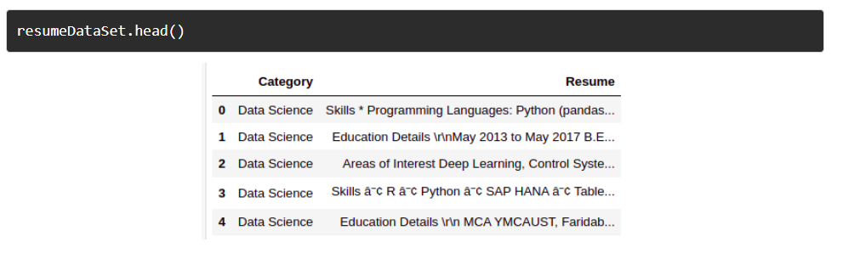
Importing file into dataset

Slide 10

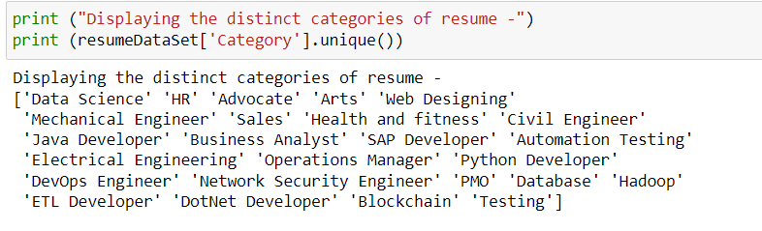
Exploratory Data Analysis
1. Check the categories of resumes in dataset.

Slide 11
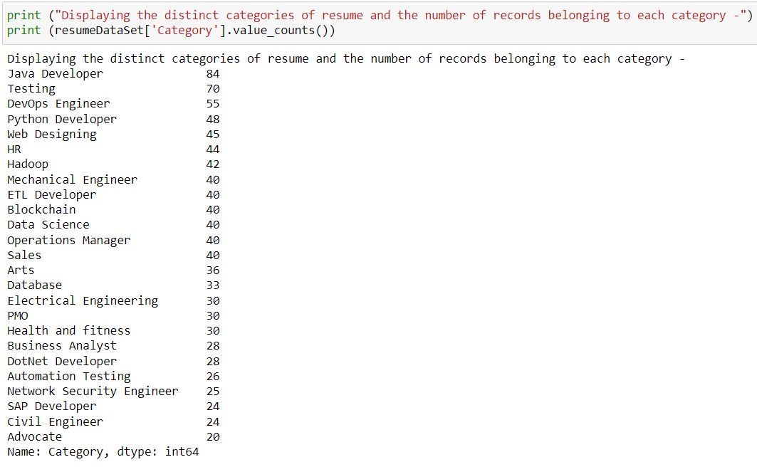
Exploratory Data Analysis
2. The distinct categories of resume and the number of records belonging to each category

Slide 12
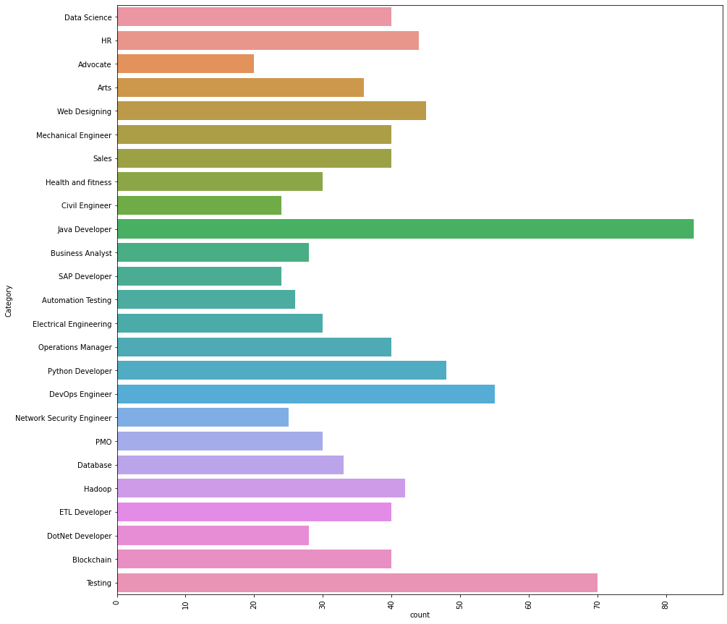
Exploratory Data Analysis
3. Viewing the visual view of categories There are 25 different categories we have in the data. The top 3 job categories we have in the data are as follows. Java developer, Testing, and DevOps Engineer.

Slide 13
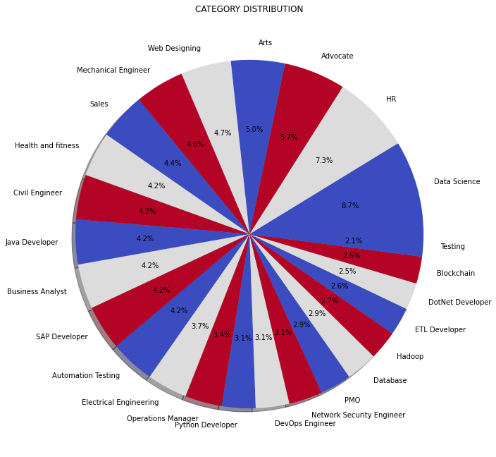
Exploratory Data Analysis
4. We can also visualize the distribution of job categories in percentage as below:

Slide 14

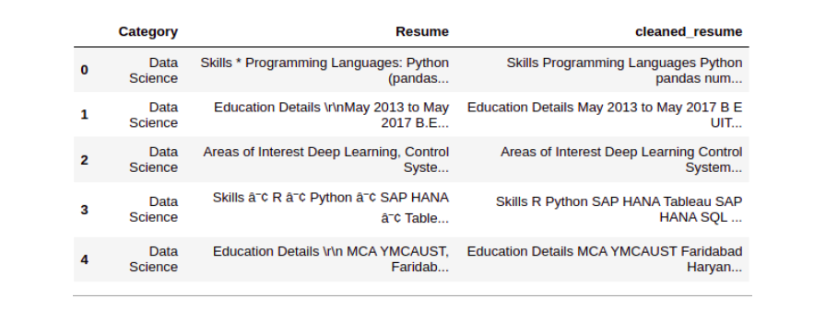
Data Processing
Data Processing
Step 1: Clean the ‘Resume’ column
In this step, we remove any unnecessary information from resumes like URLs, hashtags, and special characters.

Slide 15
Data Processing
Data Processing
Step 2: Encoding ‘Category’
Here, we will encode the ‘Category’ column using Label Encoding. Even though the ‘Category’ column is ‘Nominal’ data we are using Label Encoding because the ‘Category’ column is our ‘target’ column. By performing Label Encoding each category will become a class and we will be building a multiclass classification model.
Step 3: Pre-processing ‘cleaned_resume’ column
Here we will pre-process and convert the ‘cleaned_resume’ column into vectors. There are many ways to do that like ‘Bag of Words’, ‘Tf-Idf’, ‘Word2Vec’ and a combination of these methods.
We will be using the ‘Tf-Idf’ method to get the vectors in this approach.
We have ‘WordFeatures’ as vectors and ‘requiredTarget’ and target after this step.

Slide 16
Word Cloud is a data visualization technique used for representing text data in which the size of each word indicates its frequency or importance. Significant textual data points can be highlighted using a word cloud Steps to follow- Import nltk & wordcloud- the necessary libraries. Select the text & amount of text as stopwords, and create an array. Create a loop that will clean and check the tokenize words in the range iterations. Use frequency distributions to count number of times the outcome occurs. Build the wordcloud.
WordCloud

Slide 17
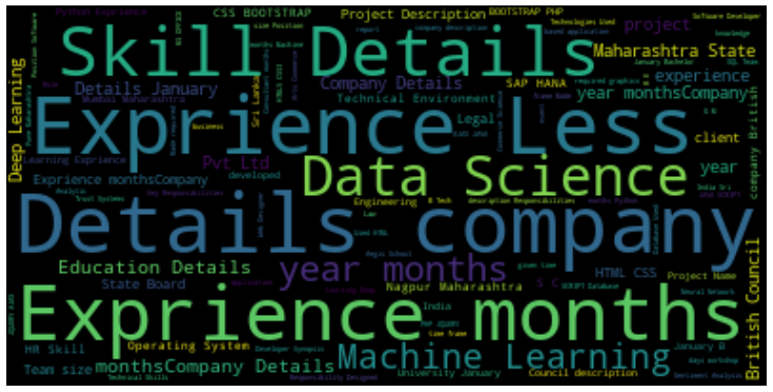
WordCloud

Slide 18
Building Model & Reviewing Results
In this process, we will train a model for the task of Resume Screening
We will be using the ‘One vs Rest’ method with ‘KNeighborsClassifier’ to build this multiclass classification model.
We will use 80% data for training and 20% data for validation by splitting the data now into training and test set.
And after getting train and test data we’ll build the model.
Finally, will review the classification results.

Slide 19
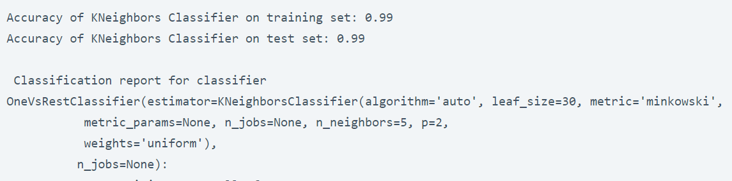
Building Model & Reviewing Results

Slide 20
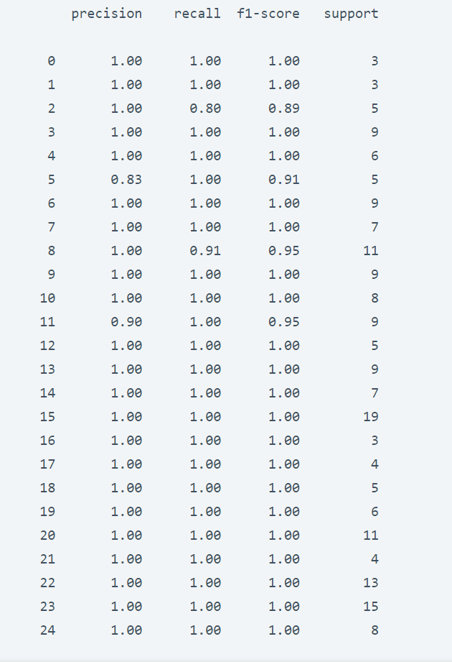
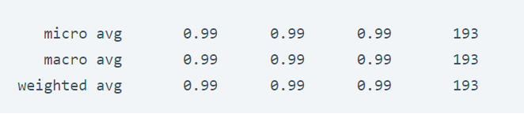
Building Model & Reviewing Results

Slide 21


What’s Next?
The main future scope of our project could be extended to parse resumes from different applications and websites like LinkedIn, GitHub, Naukri.com, etc. In future, this system can be made more versatile in which wide ranges of psychometric tests will be added. As a future work, we can enlarge the resume dataset and improve the performance of the proposed system.

Slide 22

Thank you
Sana Jalgaonkar​
+918956574654
sanajalgaonkar2810.sj@gmail.com

